Slide 1
Siteline
A council-specific property planning due diligence app

Slide 2
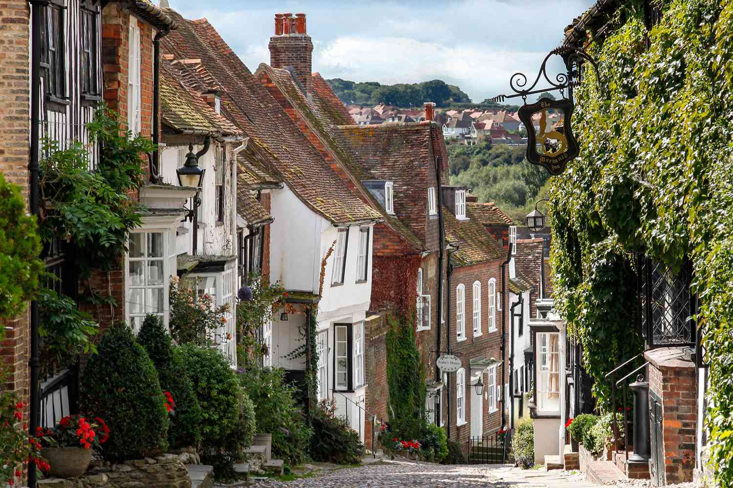



What did we build?
An app for property developers to find places to build, and receive detailed information about the risk each location and council brings
Uses the IBEX API, combined with many publicly available datasets such as income, the green belt, and construction information
1

Slide 3
What makes it different?
Planning Permission and risk can be highly political, it is not easy to simply predict
We aim for highly precise statistics to generate predictions
Our risk reports use this to generate suggestions, risks, and caveats – well beyond a basic yes or no
2

Slide 4
Usages and limitations
Developers of specific properties: ”We want to build a school…”
However, you can never truly know what will happen in the market
Reports serve as advice only
Data could be expanded Local plans, conservation data…
3

Slide 5
The numbers
Our model:
Accuracy: 0.92
Average Precision: 0.96
Area Under ROC: 0.78
Expected Calibration Error: 0.01
4

